Slide 1

CSE570 MACHINE LEARNING WITH PYTHON
Lecture #0
The kick start session

Slide 2
Course Overview
Course Code : CSE570
LTP – 2 0 2 [Two Lectures and Two Practical's/week]
Credits – 3

Slide 3
Marks Breakup
Credits : 3
Marks Breakup:
* 2 Cas, CA1-30 marks and CA2(Project)- 100 marks and CA3(Test)-30 marks
* No MTE
Activity | Marks
Attendance | 5
Continuous Assessment | 45
End-Term Practical (ETP) | 50
Total | 100

Slide 4
CA for this course
CA1 : BYOD PRACTICAL
Allotment/Submission week:5/6 week
3 scenario- based questions in fraction of 10 marks each.
CA2 : Skill Based Assessment
Allotment/Submission week:5/11 week
A) Problem Statement (Objectives) and Dataset (10 Marks)
1. Problem Statement (5 Marks)
2. Dataset (5 Marks)
B) Implementation (Outcome), Report, and Viva (60 Marks)
1. Implementation (30 Marks)
a) Data Cleaning and Visualization (5 Marks)
b) EDA and Statistical Analysis (10 Marks)
c) Model development and evaluation(15 Marks)

Slide 5
2. Report (10 Marks)
a) Format (5 Marks)
b) Technical Writing (5 Marks)
3. Viva (20 Marks)
C) LinkedIn Engagement (10 Marks)
1. Likes (6 Marks)
2. Comments (4 Marks)
D) GitHub Contributions (20 Marks)
1. Commits (10 Marks)
2. Pull Requests (5 Marks)
3. Stars (5 Marks)
CA3 : Test
Subjective test covering syllabus of CA1 and CA2

Slide 6
Books:
Text Books:
PYTHON FOR DATA SCIENCE, By MOHD. ABDUL HAMEED, WILEY
References:
1. FOUNDATIONAL PYTHON FOR DATA SCIENCE, By KENNEDY BEHRMAN, Pearson
2. DATA SCIENCE AND MACHINE LEARNING USING PYTHON, By REEMA THAREJA, MC GRAW HILL

Slide 7
Innovative Pedagogies
Case-Based Learning: Fraud detection using classification models
Flipped Classroom: Watch model theory videos, implement in class
Competitions: ML modeling on open data (e.g., student dropout prediction)
ML Debugging Relay: Groups fix broken/biased models and justify solutions
Model Olympics: Compete for best performance on same dataset using different models
Interactive Quizzes: Concept check after each algorithm, conduct quizzes

Slide 8
Gaming Pedagogies
Model Mastermind: Teams build models on the same dataset; best performance wins.
Guess the Algorithm: Students identify algorithms from outputs like graphs or metrics.
Data Cleaning Relay: Groups race to clean messy datasets using correct preprocessing steps.
Debug This Model! : Students fix faulty ML code/models and explain the errors.

Slide 9
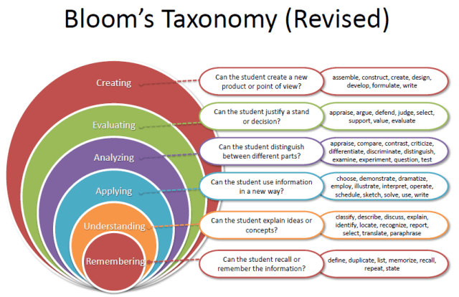
Revised Bloom’s Taxonomy

Slide 10
Program Outcomes
PO1 :
Research and Problem Solving : Ability to independently carry out research /investigation and development work to solve practical problems.
PO2 :
Technical Communication : Ability to write and present a substantial technical report/document.
PO3 :
Comprehensive Discipline Knowledge : Demonstrate a degree of mastery over the area as per the specialization of the program. The mastery should be at a level higher than the requirements in the appropriate bachelor program
PO4 :
Modern tool Usage : Create, select, and apply appropriate techniques, resources, and modern engineering and IT tools including prediction and modeling to complex engineering activities with an understanding of the limitations
PO5 :
Ethics : Apply ethical principles and commit to professional ethics and responsibilities and norms of the engineering practice.
PO6 :
Life-long learning : Recognize the need for, and have the preparation and ability to engage in independent and life-long learning in the broadest context of technological change.

Slide 11
Program Specific Outcomes
PSO1
Apply strong mathematical, statistical, and computational principles to model, analyze, and interpret complex datasets for solving real-world engineering and analytical problems.
PSO2
Design and develop scalable data science and analytics solutions using modern tools and technologies such as machine learning, deep learning, big data frameworks, and cloud platforms.

Slide 12
Course Outcomes
CO1::understand Python-based tools and libraries used for machine learning.
CO2::apply data preprocessing, cleaning, encoding, and scaling techniques for ML datasets.
CO3::analyze datasets using Pandas, NumPy, visualization, and exploratory data analysis.
CO4::understand supervised ML models for regression and classification problems.
CO5::apply unsupervised learning techniques such as clustering and dimensionality reduction.
CO6::apply Python libraries to build, tune, save, and interpret machine learning models for predictive analytics tasks.

Slide 13
Why Machine Learning?
High demand across all industries
Drives data-informed decision-making
Offers competitive business advantage
Optimizes processes and resources
Enhances customer understanding and experience
Enables future-ready organizations

Slide 14
A Valuable Skillset
Uses historical data and models
Applies statistical and AI techniques
Identifies trends and patterns clearly
Predicts future events with accuracy
Supports smarter strategic business planning
Increases employability and job prospects

Slide 15
Course Content
Unit I
Python fundamentals and Data Preparation for Machine Learning : Python essentials, NumPy arrays, Pandas DataFrames, data loading, missing value handling, encoding categorical variables, feature scaling, train-test split
Unit II
Exploratory Data Analysis and Feature Engineering : EDA, visualization, correlation analysis, outlier detection, feature selection, feature transformation, data imbalance handling, data preprocessing pipelines
Unit III
Supervised Machine Learning – Regression : Simple Linear Regression, Multiple Linear Regression, Polynomial Regression, Regularization, Ridge, Lasso, Elastic Net, regression evaluation metrics such as MAE, MSE, RMSE, R squared

Slide 16
Unit IV
Supervised Machine Learning – Classification : Logistic Regression, KNN, Decision Tree, Random Forest, SVM, Naïve Bayes, classification metrics, confusion matrix, accuracy, precision, recall, F1- score, ROC-AUC
Unit V
Unsupervised Learning and Dimensionality Reduction : K-Means Clustering, Hierarchical Clustering, DBSCAN, PCA, clustering evaluation, silhouette score, real-world clustering applications
Unit VI
Model Evaluation, Optimization and Recent Trends : Cross-validation, hyperparameter tuning, GridSearchCV, RandomizedSearchCV, model persistence, ML pipelines, introduction to ensemble learning, XGBoost/LightGBM, basics of explainable AI, ethical issues in ML

Slide 17
ICT Tools
ICT Tools Used: Python (with libraries like scikit-learn, pandas, matplotlib, seaborn,etc)

Slide 18
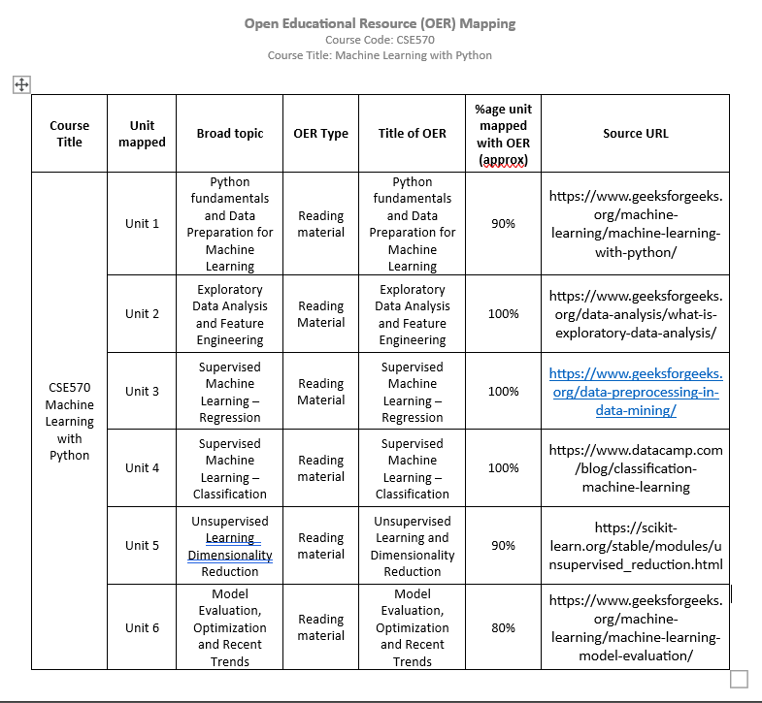

Slide 19
EduRev Initiatives
students can access and participate through the Edu-Revolution interface:
UMS Navigation → LMS > Edu-Revolution: Be the Change
Category -Recognition of Prior Learning (RPL)
Application
Students who have applied statistics, Python programming, and machine learning techniques during their internship experience will be considered for RPL
Students who have successfully completed any proctored certification or NPTEL course relevant to statistics, Python programming, or machine learning will be considered for RPL

Slide 20
Category-NPTEL/MOOCs/Certification
NPTEl/MOOCS | Agency | WebURL
Introduction to Machine Learning, IIT Kharagpur Prof. S. Sarkar | NPTEL | https://nptel.ac.in/courses/106105152
Introduction to Machine Learning, IIT Madras Dr. Balaraman Ravindran | NPTEL | https://nptel.ac.in/courses/106106139
Google Professional Machine Learning Engineer | Google Cloud | https://cloud.google.com/learn/certification/machine-learning-engineer
AWS Certified Machine Learning | Offered by Amazon Web Services (AWS) | https://aws.amazon.com/certification/certified-machine-learning-specialty/

Slide 21
Category Projects
If student is a winner in recognized national-level hackathons or innovation competitions such as Smart India Hackathon (SIH)
Project should be AI/ML-based project

Slide 22
Category-Grade Upgradation (Core)
Description
Winners of Hackathon at National/International Level
Paper publication in Q1 SCI/Scopus Journals (Elsevier, IEEE, Springer)
Winners of Smart India Hackathon (SIH) Patent granted

Slide 23
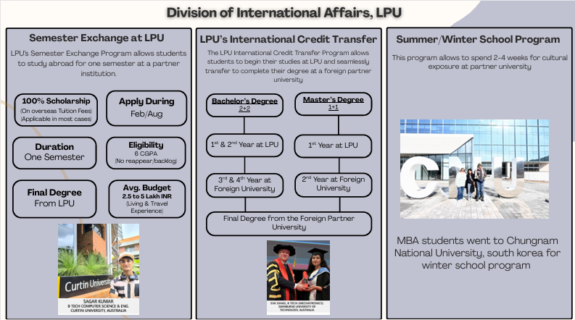
International Opportunities

Slide 24
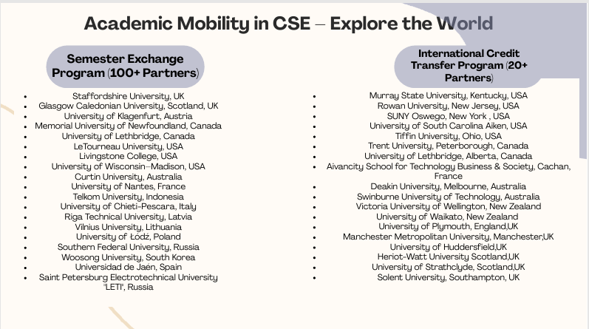

Slide 25


Slide 26


Slide 27
Thank you ☺

